Slide 1
Key Decision (title should include keywords but doesn’t have to be question)
Owner:
Decision Maker:
Integration Event:
PROJECT NAME
Key Decision #__
Font size at least 12 pt.
No more than two additional slides
Ready for Decision
The Key Decision
What We Have Learned – summary of all Knowledge Gaps
The Purpose (link back to the project’s Objectives)
What We Have Done – summary of work to close knowledge gaps and build stakeholder alignment around decision
What We Recommend / What We Have Decided
Notes:
This is an example of a Key Decision report – as soon as possible, replace it with one of your own.

Slide 2
Knowledge Gap:(title should include keywords but doesn’t have to be question)
Owner:
Contributors:
Learning Cycle:
PROJECT NAME
Knowledge Gap #______
Font size at least 12 pt.
No more than two additional slides
In Progress
The Question to Answer:
What We Have Learned
The Purpose (link back to the Knowledge Gap’s Key Decision):
What We Will Do / What We Have Done (summary of your plan to close the KG)
Done:
Planned:
Recommendations and Next Steps
Notes:
This is an example of a Knowledge Gap report – as soon as possible, replace it with one of your own.

Slide 3
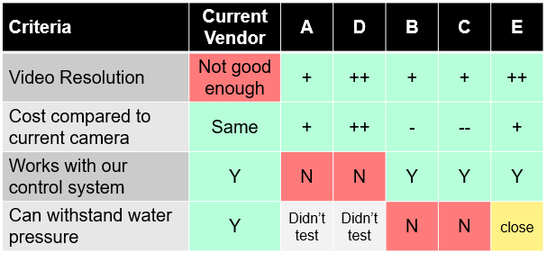
Klickitat’s Video Solution
Owner: Jim Smith
Decision Maker: Suzanne Brown
Integration Event: March 31, 2024
KLICKITAT UNDERSEA ROBOT
Key Decision #03
Font size at least 12 pt.
No more than two additional slides
Ready for Decision
The Key Decision
Who will provide the Klickitat’s video solution?
What We Have Learned – summary of all Knowledge Gaps
As of today, none of the alternative vendors provide solutions that are better than our current vendor.
Analysis:
These results show two possibilities which would require further work:
1) Work with current vendor to improve their video resolution. They are highly motivated to work with us so that they can secure the Klickitat series contracts.
2) Approach Sonoria (option E) to see if they are willing to work with us to improve their seals to withstand the water pressure. Although the technical challenges are smaller, we have no prior relationship with them and so any co-development partnership would be a lot more risky.
Conclusion:
Our best option is to work with our current vendor to develop the improved video resolution.
The Purpose (link back to the project’s Objectives)
We want improved remote control and video recording in our undersea robot, compared to our current vendor’s video capabilities. We must choose a video solution tool by start of 3rd quarter to meet target launch date. If we don’t have better video, our competitors will take over. There’s lots of video cameras available but we don’t know if they can survive submersion.
What We Have Done – summary of work to close knowledge gaps and build stakeholder alignment around decision
KG 03-01: Which cameras from which vendors might meet our needs? We found five candidates from three vendors.
KG 03-02: Can the candidate cameras be controlled by our control system on dry land? This eliminated two vendors.
KG 03-06: Which candidate cameras can survive a hydrostatic pressure test? We tested three cameras in via hydrostatic pressure test. Two failed completely. The third failed the test but seemed close, if we were willing to let them leverage our expertise to improve the seals.
Approached our current vendor about the possibility of joint development on a camera that has the functionality we need.
What We Recommend / What We Have Decided
Execute a co-development agreement with our current vendor to improve the video resolution of their camera.
Notes:
Here’s how it looks in the report.
Notice that if the recommendation is overridden and the decision-makers choose a different path,
This report will still show all the reasoning.
If decisionmakers decide to go with Sonoria, everyone will be able to see the risks and the benefits because you laid out both options.
When a recommendation is overridden, that usually means there are criteria in the minds of the decision-makers which you did not take into account completely.
Or new late-breaking knowledge arrived.
The next lesson will cover presenting the Key Decision Report and recommendation in the Integration Event to the Decision makers.

Slide 4
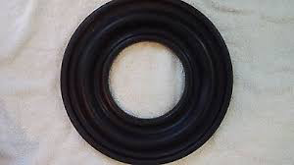
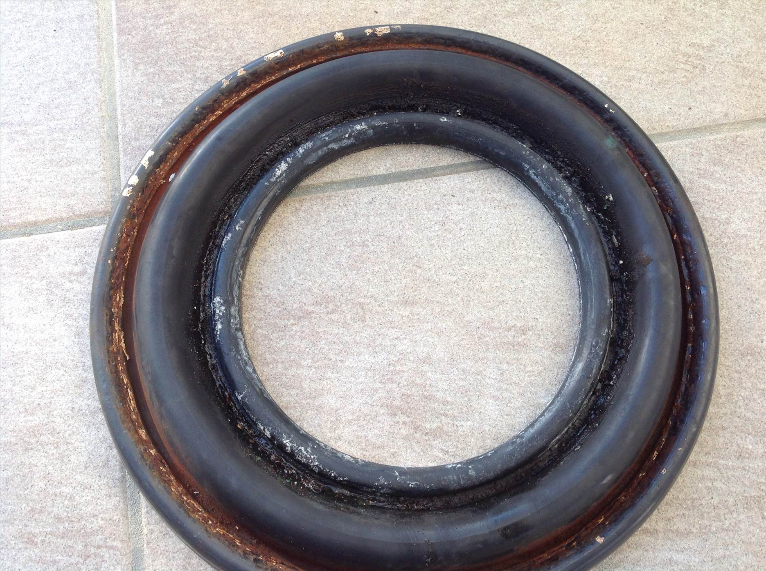
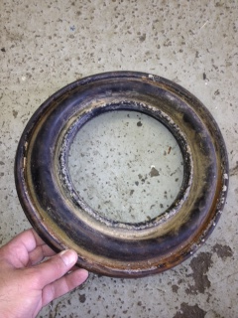
Can Sonoria’s new line of cameras replace our existing vendor’s solution?
Owner: Jim Smith
Other Contributors: Eileen Black, Joe Malloy
Learning Cycle: LC3 - March 31, 2024
KLICKITAT UNDERSEA ROBOT
Knowledge Gap #03-06
Font size at least 12 pt.
No more than two additional slides
Closed
The Question to Answer:
Are the newest models of video cameras from Sonoria capable of maintaining their waterproof seals in 100 meters of water?
What We Have Learned
Two cameras did not survive the pressure test. The LX586 failed after 10 hours and the KX938 only survived for five hours before their seals failed.
The third, the GX968, remained operational throughout the test, but the seals showed signs of significant deterioration. It’s not likely to have survived a second mission.
The Purpose (link back to the Knowledge Gap’s Key Decision):
We want to increase the resolution and control features on the Klickitat, but our current vendor’s solutions don’t provide those features, so we need to decide whether or not we can replace them with a new supplier.
What We Will Do / What We Have Done
Done:
Sonoria’s new line of cameras seem to have the right specs and feature set but are unproven in deep sea applications.
We ran a hydrostatic pressure test experiment through our partnership with Seatools on samples from Sonoria of their latest line of underwater cameras (LX586, GX968, KX938)
The cameras were submerged for twelve hours at 5600 kPa (equivalent to 550m of seawater depth) on a test harness that supplied power and recorded video and other camera diagnostic data.
After submersion, the data was retrieved and analyzed for signs of failure. All cameras were disassembled and their seals were visually inspected for signs of deterioration.
New GX986 Gasket
After 8 Hours
After 12 Hours
Recommendations and Next Steps
Recommend that we drop Sonoria from consideration and continue with our existing vendor.
Notes:
This is an example of a Knowledge Gap report – as soon as possible, replace it with one of your own.

Slide 5
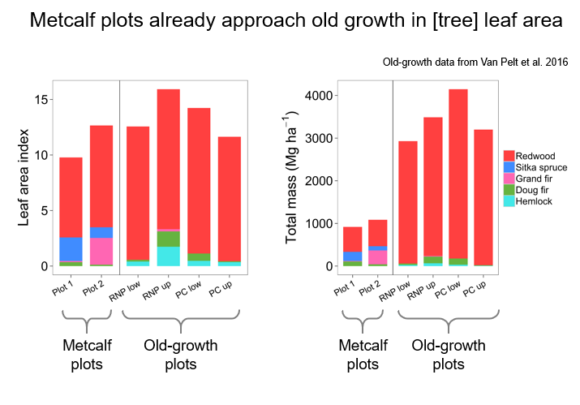
How do young redwood forests compare to old-growth forests?
Owner: Bileen Black
Other Contributors: Joe Malloy
Learning Cycle: LC3 - March 31, 2024
FORESTRY PRACTICE AND CLIMATE CHANGE INVESTIGATION
Knowledge Gap #04-12
Closed
The Question to Answer:
How do second-growth redwood forests compare to old-growth forests in leaf area and total tree mass?
What We Have Learned
The Purpose
We want to slow climate change by sequestering lots of carbon fast. Old-growth redwoods sequester fast enough to make a difference, but we don’t have many old-growth redwood forests. We think second-growth redwood forests may sequester carbon fast enough to be worth the opportunity cost of preserving them. However, we aren’t sure how fast second-growth forests sequester carbon as they age.
What We Will Do / What We Have Done
Done:
Surveyed the two 135-year-old Metcalf second-growth redwood plots to measure standing and fallen trees. Estimated leaf area and total mass based on those measurements, using allometric equations from previous studies. Compared the results to those of previously measured old-growth redwood plots.
Assumptions based on results from previous studies:
Rate of carbon sequestration by trees is roughly proportional to total leaf area.
Amount of carbon sequestered is proportional to tree mass.
Tree mass can be estimated from several standard tree measurements.
Once sequestered, carbon stays sequestered until tree dies and decomposes.
We learned that a 135-year-old redwood forest sequesters carbon at nearly the same rate per hectare as an old-growth redwood forest. Preservation of stands of this age would help slow climate change.
The next question: When did these plots reach this total leaf area index? The answer would be very helpful to inform forest management practices relative to slowing climate change.
Recommendations and Next Steps
Recommend that this Knowledge Gap be closed.
Recommend a new Knowledge Gap: What was the LAI and mass of these plots at younger ages? There are measurements from 1963 and 1990 which might work.
Iberle, Benjamin G.; Sillett, Stephen C.; Van Pelt, Robert; Andre, Mark. 2017. Ninety-two years of tree growth and death in a second-growth redwood forest. In: Standiford, Richard B.; Valachovic, Yana, tech cords. Coast redwood science symposium—2016: Past successes and future direction. Proceedings of a workshop. Gen. Tech. Rep. PSW-GTR-258. Albany, CA: U.S. Department of Agriculture, Forest Service, Pacific Southwest Research Station: 35-38. . https://www.fs.usda.gov/treesearch/pubs/55408
Notes:
Biomass= mass of a living thing.
Allometric equation = predicts a property of an object based on a measured dimension. E.g. estimate mass based on DBH and height. Based on relationships established in previous thorough measurements.
Tree mass estimated by diameter, height, and in some cases estimated crown height and radius too. Also requires allometric equations and tables.
Note: the final research paper did include the longitudinal study. The second Knowledge Gap was not conclusively closed because the available data from student projects in previous years were too far apart in time to show the growth of leaf area index with sufficient precision.

